Slide 1
MBA532 – AI in Business
MODULE 8 – AI Ethics and Responsible AI

Slide 2
Responsible AI
Responsible AI

Slide 3
What is Responsible AI?
Responsible AI: AI systems should be designed and implemented in ways that recognize, and are sensitive to, human interaction contexts without infringing core values or human rights.
AI designers are responsible for the development of intelligent systems that follow fundamental human principles and values, to always ensure human well-being.
Design, development and use of AI must take into account societal values, moral and ethical considerations, accommodate values of different stakeholders, explain its reasoning for decisions, and guarantee transparency.

Slide 4
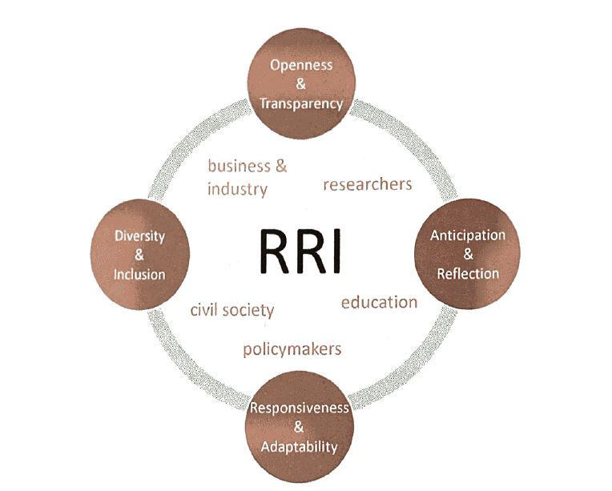
Responsible Research and Innovation Process (RRI)
RRI: a “transparent, interactive process by which societal actors and innovators become mutually responsive to each other with a view to (ethical) acceptability, sustainability and societal desirability of the innovation process and its marketable products.”

Slide 5
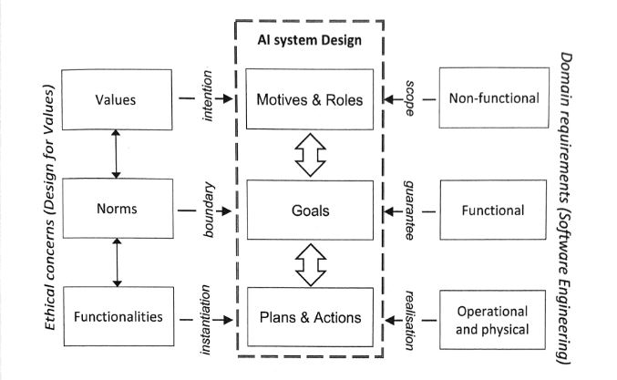
Responsible AI Design
Responsible AI design integrates ethical concerns and domain considerations into the development process of AI applications.

Slide 6
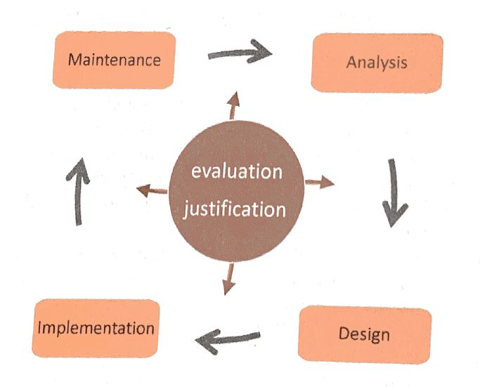
Responsible Development Life Cycle for AI

Slide 7
How to judge an ethical action by an AI system?
Dennett identifies three requirements for ethical action by an AI agent:
It must be possible to choose between different actions;
There must be some societal consensus that at least one of the possible choices is socially beneficial;
The agent must be able to recognize that socially beneficial action and take the explicit decision to choose that action because it is the ethical thing to do.

Slide 8
Considerations Before Design of Decision-Making Mechanisms for Moral AI Systems
There are three considerations before incorporating ethical decision-making mechanisms into AI systems:
Algorithmic: the aim is to incorporate moral reasoning fully in the system’s deliberations. An AI can autonomously evaluate the moral and societal consequences of its decisions and use that in its decision-making process.
Human in command: a person or group of humans take part in the decision process.
Regulation: require or incorporate ethical decision making into the systemic infrastructure of the environment. In this case, the regulated environment ensures that the system will never get into moral dilemma situations.

Slide 9
Absence or weak Regulation should not matter
Given the dynamic nature of AI, we cannot wait for regulation until the technology is mature.
It is important to realize that not all regulation is negative, especially when regulation takes the form of incentives or investment programs that nudge organizations toward a specific application or technology.
AI is an artifact; all product and service liability laws apply to AI. As a protection against such liability, businesses should pay for AI insurance coverage.
Regulation implies that further scientific development of AI is allowed as long as regulation remains in effect.

Slide 10
The King Midas Problem
Humans may suffer from a failure to properly implement value alignment in AI systems, and this may be passed on to future generations of AI systems.
That is, we may, perhaps inadvertently, imbue machines with objectives that are imperfectly aligned with our own.
E.g. The reinforcement learning algorithms that optimize social-media click-through have no capacity to reason about human behavior. However, for (potentially adversarial) machines with much greater understanding of human psychology, beliefs, and motivation, it should be relatively easy to gradually guide us in the direction that increase the likelihood that the machine’s goals are achieved instead of human goals.

Slide 11
Focus on Principles for Beneficial Machines
Three design principles guide AI researchers and developers; the goal here is to create beneficial AI systems by design:
Purely altruistic machines: the machine’s objective is to maximize the realization of human preferences.
Humble machines: the machine is initially uncertain about what those preferences are.
Learning to predict human preferences: the ultimate source of information about human preferences is human behavior.

Slide 12
Assistance Games
Assistance games provide a useful conceptual framework. They depict situations where a human has preferences and acts according to those preferences, and an observant robot doesn’t know what those human preferences are but it wants to satisfy them anyway; as a result, the robot asks questions to learn those preferences.
The most interesting property of assistance games is that, by solving the game, a robot can understand how to process human behaviors as a source of information about human preferences.

Slide 13
What Are Beneficial Machines
Beneficial machines: machines whose actions help to achieve beneficial human objectives.
Machines designed in this way will defer to humans: they will ask permission; they will act cautiously when guidance is unclear; and they will allow themselves to be switched off.
E.g. self-driving cars are notoriously bad at handling four-way stop signs when it’s not clear who has the right of way. By formulating this as an assistance game, however, the car may come up with a novel solution: it actually backs up a little bit to signal or convey that it’s definitely not planning to go first. The human understands this signal and goes ahead, confident that there will be no collision. This behavior is not what human experts thought to program into the self-driving vehicle, but represents a form of communication that the vehicle invented entirely by itself!
The concept of beneficial machines is the core of a new approach to AI based on a collaborative relationship between humans and machines.

Slide 14
Data, Privacy, Compliance and Strategy
Data, Privacy, Compliance and Strategy

Slide 15
Managing Data Privacy & Compliance; Improving Digital Channels in an AI World
Step 1: Raise Awareness
Senior management should be aware about GDPR, EU’s AI Act, and State-specific AI regulations in US before they decide on a business model.
General awareness of the need for better personal data privacy practices for all. GDPR recommends tailored training events for personal data handlers.
Documentation and prioritization of risks are key.
Step 2: Complete Data and Risk Audit
All personal data should be documented, including official data storage facilities.
Assess the compliance risks involved.
Record all permissions given to personal data and how they can be shared and used.
Step 3: Privacy Policies
Businesses need to understand privacy notices, policies rights and processes.
All employees should be given training about the new rights and processes.

Slide 16
Data Privacy and Compliance… Cont’d
Step 4: Prepare Data Requests
Most companies do not have the resources to respond to data requests and failure penalties are potentially high.
Such requirements should be put in place to ensure compliance.
Smaller companies are setting up manual processes until the size of demand is clear.
Step 5: Lawful Basis of Data
Companies holding personal data should be clear on lawful basis and document them.
Training required to avoid human error.
Understand regulations to put necessary people or tools for compliance.
Step 6: Correct Consent and Legitimate Use
Audit data according to GDPR’s regulations – consent and legitimate use.
Data should be clean and maintained in a centralized database to use when needed.

Slide 17
Data Privacy and Compliance… Cont’d
Step 7: Rules for Kids and Sensitive Data
Consent of data from children by GDPR should be understood by a company.
Add extra protection to children's data and other sensitive data.
Specialist advice is recommended if this is a big part of the business model.
Step 8: Data Breach Response
Swift report of personal data breaches before risking big fines.
“High risk” captures risk to the rights of individuals – financial loss, confidentiality etc.
Large companies use semi automated services for the best scalable solution.
Step 9: Protection by Design
Rethinking personal data usage and ensuring it cannot leak by design.
Protection - building privacy into every process and system from the ground up.
Minimize, delete, protect, anonymize, encrypt and automate.

Slide 18
Data Privacy and Compliance… Cont’d
Step 10: Data Protection Officer
Having a data protection officer (DPO) may avoid some of the risk from GDPR.
A DPO is mandatory for public bodies that use a large volume of sensitive data.
The officer should be a data privacy expert who can advise employees about regulations.
Step 11: International Preparation
Personal data transfers between countries must be made under secure approved processes.
Data transfer rules are still under debate in some areas.
Step 12: Plan of Attack
Data Privacy Steering Committee with a board level sponsor and expert partners.
Data audits, risk and gaps must be handled.
Data protection and privacy policies need to be instilled.

Slide 19
AI Strategy
Many business think that the first step toward AI is digitization of all records and processes, and AI strategy follows thereafter.
While that generally is a correct sequence, AI strategy needs to thought through very carefully with organization priorities in mind.
AI can lead to a strategic change if three factors are present: (a) there is a core trade-off in the business model, (b) the trade-off is influenced by uncertainty, and (c) an AI tool that reduces uncertainty tips the scales of the trade-off such that the optimal strategy changes from the less beneficial side of the trade-off to the other.
A key strategic choice is determining where one business ends and another business starts - deciding on the boundaries of the firm. Because prediction machines reduce uncertainty, they can influence the boundary between organizations.

Slide 20
How AI – first strategy differs from general purpose AI strategy
This involves a shift in thinking. Shifting to an AI-first strategy means downgrading a previous top priority.
AI-first represents a real tradeoff. An AI-first strategy places maximizing reliance on AI as the central goal of the organization, even if that means compromising other goals such as maximizing revenue, user numbers or user experiences.
AI can disrupt because incumbent firms often have weaker economic incentives than startups to adopt AI technology. AI-enabled products are often inferior at first because it takes time to train a prediction model to perform well.
Once deployed, an AI system continues to learn and improve, leaving other products behind. Companies will find it difficult to catch up once their competitors get ahead in this phase. (see McKinsey study cited on next slide).

Slide 21
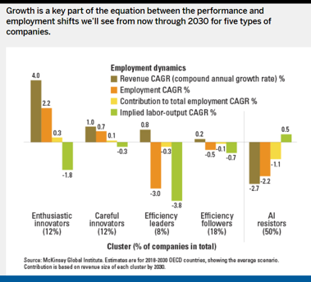
Early bird finds the worm faster in AI ….
Firms were divided into five groups as shown depending on their receptivity to AI solutions
On a range of four color coded KPI metrics, the first group (Enthusiastic Innovators on AI) outperformed all other groups. So the early adopters benefit more from AI.

Slide 22
Module 8 Summary
Attention to broad principles/guidelines of AI Ethics are critical for a business that uses AI. From a privacy perspective, this requires sensitivity to what AI systems track, anthropomorphism, biases, and building accountability, responsibility, and transparency in AI.
AI Regulations are incipient or evolving as AI technologies advance. Fairness, Privacy, and removing/avoiding biases in AI applications are most important.
Focus significant and detailed attention on compliance with current regulations (GDPR, EU’s AI Act, US state-specific regulations on AI, and Congressional deliberations on a future federal-level US regulation for AI) are important.
Formulate and implement a cogent AI strategy that is appropriate for the business.

Slide 23
Course Summary
We followed the course objectives and content for each module:
At this point, and after further reviewing course content (as needed) for learning reinforcement, students should be familiar with the AI environment and landscape. We relied on many contemporary examples from the AI/Business fields to showcase concepts and improve student learning.
It is great idea to follow developments in the media and other sources about AI-related developments, and stay turned with my LinkedIn network for developments that may alert you to new trends that emerge.
Wish you all happy adventures with AI and much success in your careers!

